Slide 1

Malicious Clickbait Detection API Extension for Chrome
An AI integrated Cyber Security project

Slide 2

In this Presentation
01
Overview of Clickbait
02
Technology Behind Detection
03
Chrome Extension Feature
04
Implementation and Integration
05
Challenges and Limitation
06
Future Direction
07
Online Advertising and Browsing Behavior
08
What's Next in Ecommerce

Slide 3



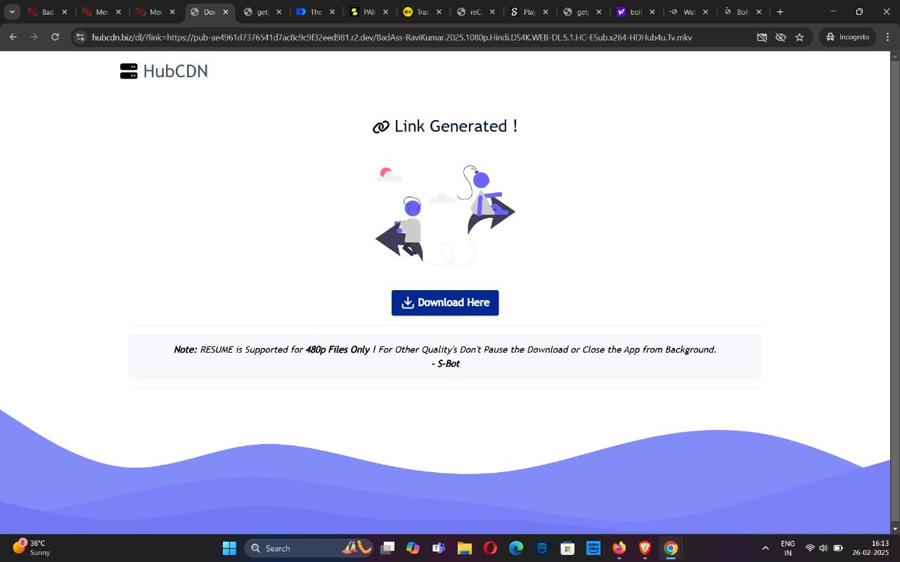
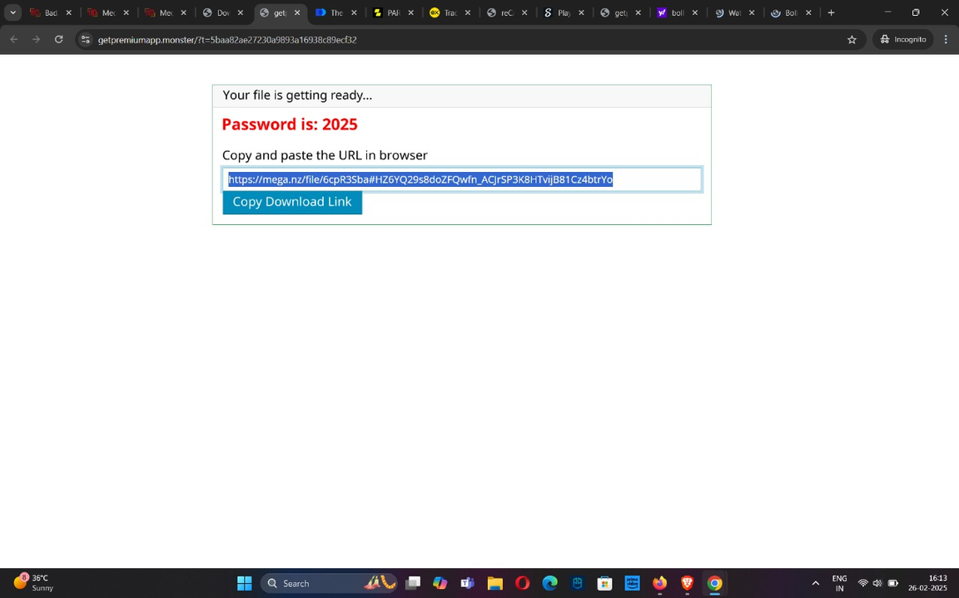
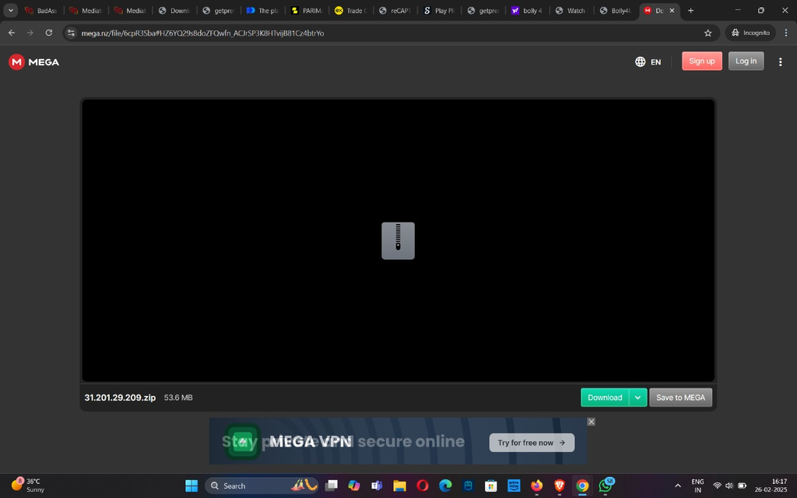
Abstract
The rapid growth of cyber threats, including phishing and malware distribution, has leveraged deceptive
headlines as a primary vector to lure victims.
This study focuses on developing an AI-based detection system to identify malicious clickbait headlines that facilitate malware installation or phishing attacks.

Slide 4

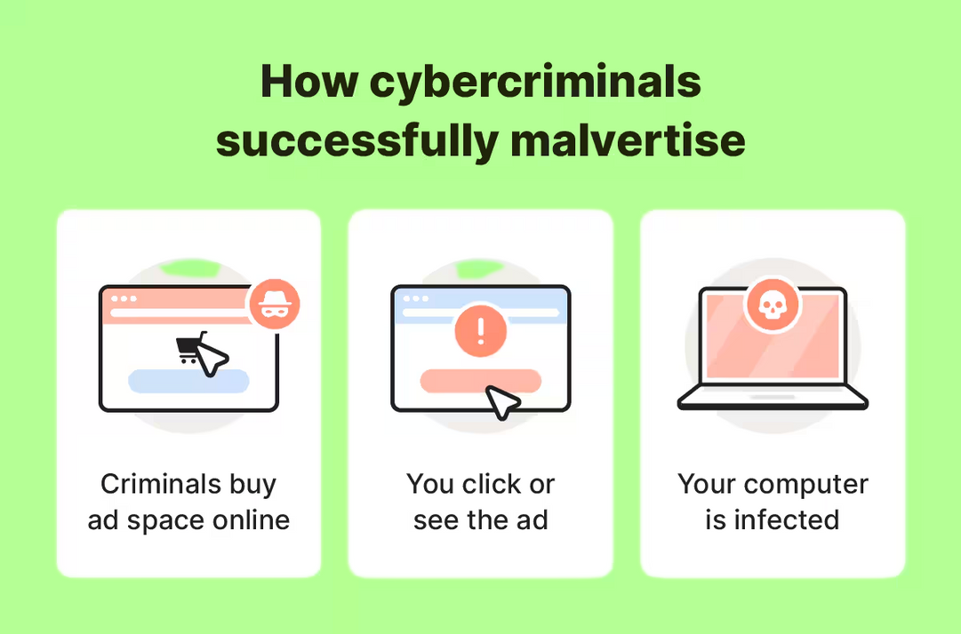
What is
CLICKBAIT!!!
Clickbait headlines have evolved into a potent tool for cybercriminals. Unlike benign clickbait designed to attract attention for entertainment or marketing purposes, malicious clickbait is crafted to deceive users into performing harmful actions such as downloading malware or divulging sensitive information.

Slide 5
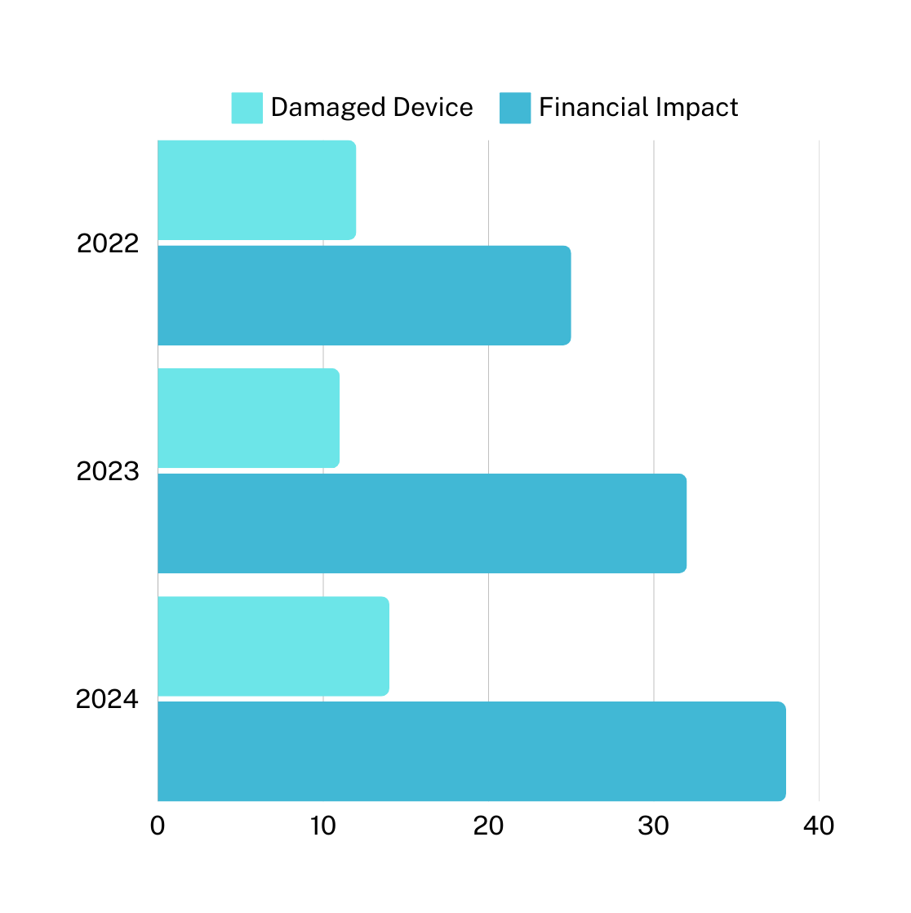

From 2022 to 2024, the number of compromised devices due to malicious clickbait rose from 1.2 million to 1.8 million, highlighting a growing concern.
12 million devices
$25 billion
The financial losses due to data breaches caused by malicious clickbait increased significantly, from $2.5 billion in 2022 to $3.8 billion in 2024.
11 million devices
$32 billion
The steady rise in both adds to compound risk underscores the urgent need for robust cybersecurity measures to combat malicious clickbait.
14 million devices
$38 billion

Slide 6

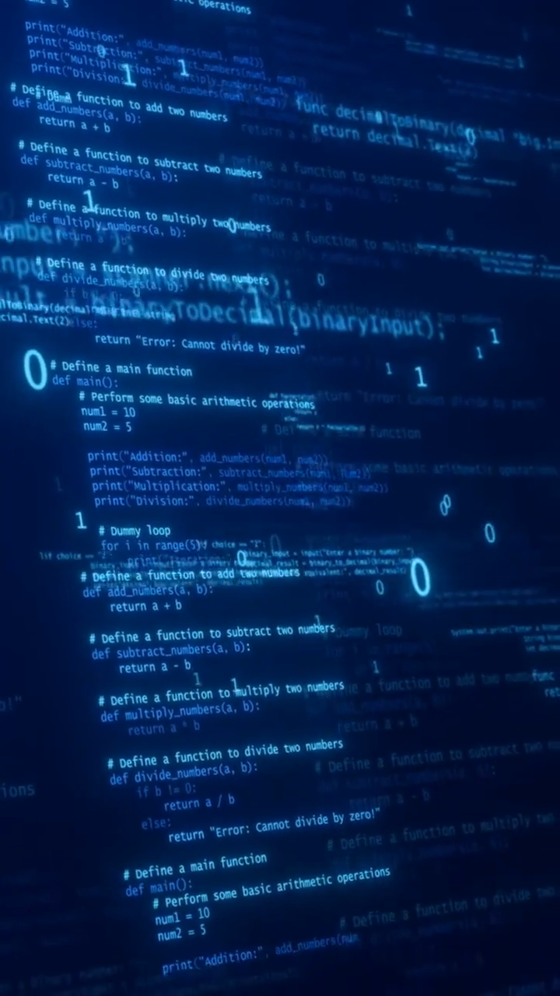
Data Collection
Step 1
Clickbait Dataset, Data Preprocessing and Vectorization by TF-IDF method
Step 2
Feature Engineering
Technology Behind Detection
Abstract meaningful features such as action-oriented verbs, urgency words and find pattern
Step 3
Model Development
Traditional machine learning techniques such as logical regression and handling imbalance dataset using SMOTE
Step 4
Evaluation
Precision, Recall and F1-Score
Step 5
Deployment
API Development using flask, UI development and Integration

Slide 7

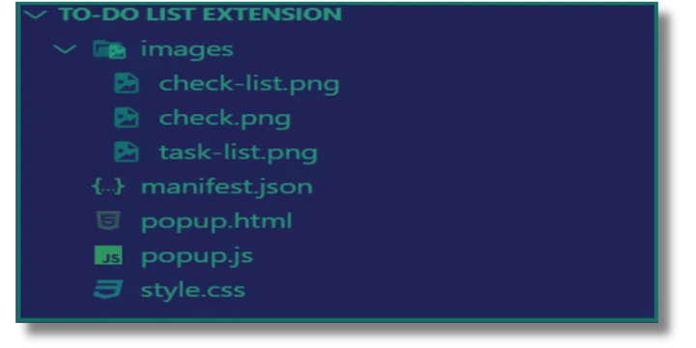

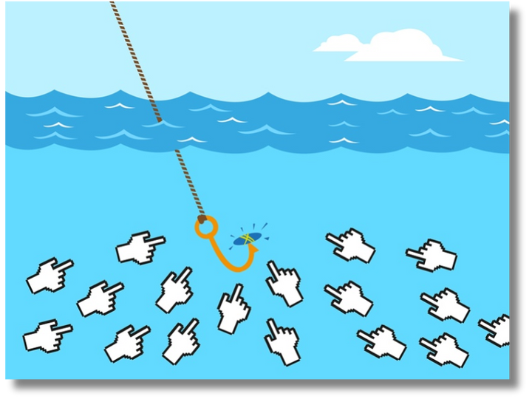
Real-Time Defence for Secure Browsing
Instant Detection: analyzes in real-time, identifying and flagging malicious clickbaits before they can cause harm.
Easy-to-use interface with pop-up alerts that notify users of potential threats, enhancing overall browsing safety.
Seamless Integration: Designed to work effortlessly with your Chrome browser, requiring minimal setup and maintenance.

Slide 8

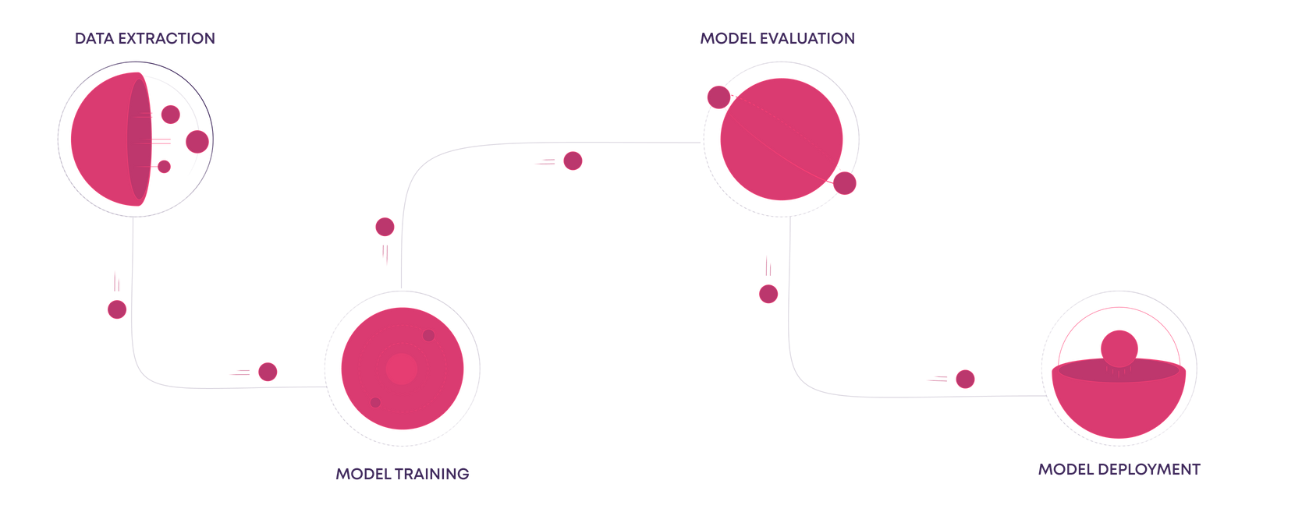


Developing the Model
01 - DATASET
02 - EMBEDDING LAYER
03 - LSTM GRU PROCESSING
04 - DENSE LAYER
05 - COMPILE
Creating a dataset with 1000 key-words including equal number of malicious and non-malicious words.
Provides a numerical representation of words that captures their meanings and relationships, making it easier for the model to process text data.
The model processes each word in the sequence, updating its internal state based on the context provided by previous words.
The Dense layer outputs a single value between 0 and 1, thanks to the sigmoid activation function, which represents the probability of the headline being malicious or not.
Prepares the model for training by specifying the optimizer, loss function, and evaluation metrics.

Slide 9

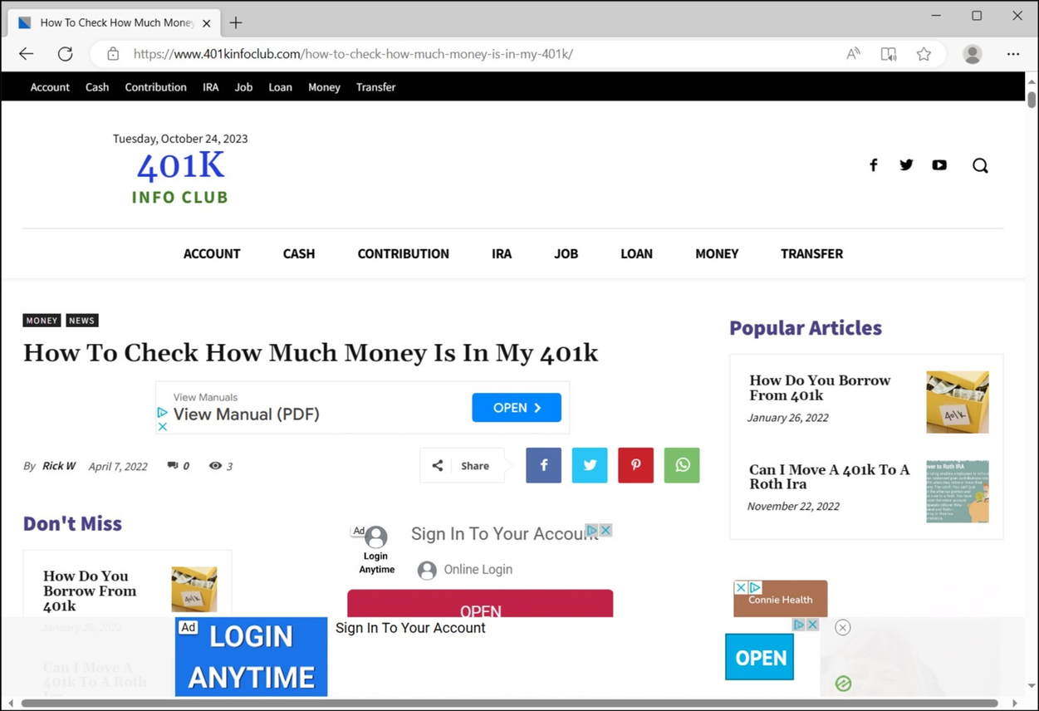
Challenges and Limitations
Subtle Malicious Intent
Some malicious headlines mimic legitimate ones closely.
It is very difficult to identify an actual link amongst multiple clickbaits
Dataset limitations
Scarcity of publicly available labeled datasets.
Limited data collection results in weak development of model.

Slide 10




Future Work
Enhance Email Security
Extend the detection system to integrate with email clients like Outlook, Gmail, and others.
Advanced NLP Models
Explore larger pre-trained models (e.g., GPT based architectures) to enhance detection accuracy and contextual understanding.
Scalability
Deploy the system for large-scale cybersecurity tools to ensure it can handle a high volume of data.

Slide 11

Presented by-
Group 66

